Slide 1

DNP Design of Experiment
Sylvia Soliez

Slide 2
Contents
Overview
Terms
Design
Recommended Statistical Methods
References
What is Diabetes?

Slide 3
Overview
PICOT Question:
For those in a Weight Loss Group or at Risk of T2D, does a community educational outreach program improve diabetes management after 8 weekly meetings?

Slide 4
Terms
T2D – Type 2 Diabetes.
Prediabetes – Showing early signs of T2D but reversible by introducing healthier habits.
A1C% (HbA1c) - Blood test done in office that measures average blood sugar levels of the past 3 months.

Slide 5
What is Type 2 Diabetes?
Body fails to produce or use insulin
“Insulin acts like a key to let the blood sugar into your body’s cells for use as energy.”
Results in high blood sugar levels
Can leads to Heart Disease, Stroke, Vision Loss, Kidney Disease.
95% of people with Diabetes has Type 2.

Slide 6
T2D Risk Factors and Management
Increased risk by Genetics, Weight, Activity Level, High Blood Pressure. Symptoms can at most go into “remission”.
T2D Management typically includes:
Losing weight
Eating healthy food
Being active
Taking medicine as prescribed
Self-management
Healthcare appointments

Slide 7
Design
Population
Patients at a Health Clinic in Minneapolis
Sampling Method
Patients include
Those with Prediabetes
Weight Loss Group
Sample Size
Dependent on patients currently enrolled.
Duration of Class
8 Weeks.
Pre-experiment Power Analysis

Slide 8
Design
Endpoint Measurements
A1C%, numeric %
Perceived Knowledge, Likert Scale
Weight Change, numeric
Waist/Hip Ratio, numeric
Type of Study
Single Group Pretest-Posttest.
Notes:
“Waist/Hip Ratio has been correlated with metabolic syndrome”

Slide 9
Design
Other Influential Factors
Patient Demographics: Ethnicity, Race, Education, Motivation
Procedure for measurement
Pre-test
Pre-diabetes Test, Customized Pre-survey
AIC% within last 90 days.
Post-test
Customized Post-survey
Others provided by Health Clinic

Slide 10
Survey Concept
Derivative from National Diabetes Prevention Program – Participant Registration Form
Include the DVs of interest
Post-Implementation Survey
Remeasures changed variables (DVS of interest)

Slide 11
Recommended Statistical Methods
Measure general improvement:
1
Paired T-Test for each dependent variable.
Wilcoxon Sign test if assumptions violated.
Measure within-group(gender, ethnicity, etc.) improvement.
2
Mixed Design ANOVA.
Friedman Test if assumptions violated.

Slide 12
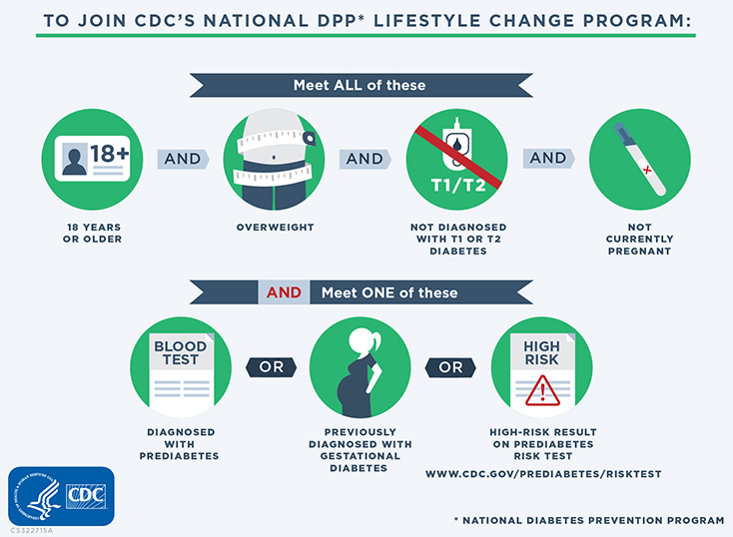
References
https://www.cdc.gov/prediabetes/risktest/index.html
https://www.cdc.gov/diabetes/basics/diabetes.html

